Slide 1
MAR 530: Ecosystem Based Fisheries Management
Lecture 11
Governance & Management Institutions
www.mycourses.umassd.edu
17 April 2015

Slide 2
Last Time…
People are important.
Economic and Societal considerations

Slide 3
Today’s Outline
Basis for Governance
Governance Institutions
Discussion on:
Costanza et al. 1998
Gutierrez et al. 2011
Sissenwine & Mace 2003

Slide 4
One Main Theme Throughout Course
CONFRONTING TRADEOFFS

Slide 5
Simplified Schedule
Week | Theme | Topic
1/30 | Context | Introduction, What is EBFM?
2/6 |  | Challenges facing fisheries, what can EBFM offer?
2/13 |  | Guest lecture: case studies of EBFM
2/20 |  | Types of advice, decision theories, goal-setting
2/27 | Operational | Bycatch, habitat, and spatial management
3/6 |  | Ecosystem indicators
3/13 |  | Extended single-species and multispecies models
3/20 |  | SPRING BREAK
3/27 |  | Aggregate and system models
4/3 |  | Ecological risk assessment
4/10 | Institutional | Societal and economic considerations
4/17 |  | Governance and management institutions
4/24 | Holistic | Evaluating tradeoffs
5/1 |  | Moving towards ecosystem based management
5/8 |  | Final exam: Project Presentations

Slide 6
Defining Fisheries Governance
FAO: http://www.fao.org/fishery/topic/2014/en
guiding principles and goals, both conceptual and operational;
the ways and means of organization and coordination;
the infrastructure of socio-political, economic and legal institutions and instruments;
the nature and modus operandi of the processes;
the actors and their roles;
the policies, plans and measures that are produced; as well as
the outcomes of the exercise.

Slide 7
Defining governance
“Governance is the whole body of public as well as private interactions taken to solve problems and create societal opportunities. It includes the formulation of principles guiding those interactions and care for institutions that enable them” (Kooiman and Bavinck, 2005).

Slide 8
Fishery governance (FAO)
Has international, national, and local dimensions.
Includes legally binding rules, such as national policies and legislation or international treaties as well as customary social arrangements.
Multi-scale, covering long-term strategic planning as well as short-term operational management, and local fisheries as well as whole ecosystems.
Public, private, and hybrid components that interact in ensuring administration and regulation of the sector.

Slide 9
Basis for governance and management institutions
In most instances, there are international or national or even regional Laws that form the basis for natural resource management.
Legislative mandates on which policies are based
A need to “unpack” laws and policies to broad goals, followed then by specific goals.

Slide 10
Significant U.S. Legislation that Influences Living Marine Resources and Marine Ecosystems
1900 Lacey Act
1929 Migratory Bird Conservation Act
1934 Fish and Wildlife Coordination Act (FWCA)
National Environmental Policy Act (NEPA)
Coastal Zone Management Act (CZMA)
1972 Clean Water Act (CWA)
1972 (1994) Marine Mammal Protection Act (MMPA)
1972 Marine Protection, Research and Sanctuaries Act
1973 Endangered Species Act (ESA)
1976 Fisheries Conservation and Management Act (MFCMA 1996), Sustainable Fisheries Act (SFA, 2007)
1980 Comprehensive Environmental Response, Compensation and Liability Act (CERCLA or “Superfund”)
1986 Interjurisdictional Fisheries Act (IFA)
plus Anadromous Fish Conservation Act, Atlantic Striped Bass Conservation Act, Atlantic Coastal Fisheries Cooperative Management Act, Atlantic Tunas Convention Act, Northwest Atlantic Fisheries Convention Act, Central, Western, and South Pacific Fisheries Development Act, etc.- besides all the International Treaties and Agreements

Slide 11

There are over 100 pieces of legislation (i.e., laws) that impact living marine resource management in the US. Plus, International treaties & conventions

Slide 12
“Not only was an ecosystem management approach legal, it was mandatory if all applicable laws were to be simultaneously obeyed.” Jack Ward Thomas

Slide 13
Unpacking Laws & Platitudes
From National Law & Policy
e.g. Endangered Species Act
To Conceptual objective
e.g. Biodiversity is good
To Operational objective
e.g. no loss of species richness

Slide 14
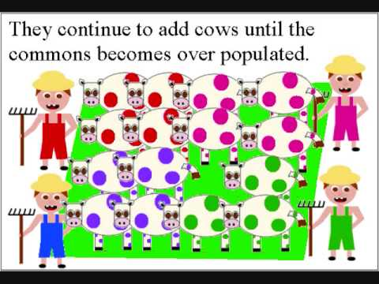
The need for governance & management
Why bother… why do we need Governance Institutions?

Slide 15
The need for governance & management
Why bother… why do we need Governance Institutions?
100% of people do not act 100% legally, ethically, and morally 100% of the time
Even if they did, there would still be legitimate differences in perspectives, opinions, worldviews, etc. that need to be resolved

Slide 16

The need for Governance Institutions
What are governance institutions for?
Frameworks or process in which to do natural resource management
Need for equitability in allocation of resources, particularly those in the public domain
Need to provide enforcement mechanisms.

Slide 17



Link’s three pillars of management system
1. Goal Setting (Priorities & Allocation of Biomass)
2. Assessing [Ecosystem] Status (Multivariate metrics)
3. Achieving [Ecosystem] Goals (Management Tools)

Slide 18
Governance Frameworks
Legally allows society to develop and implement the “institution” of this management system
Allow a “place” for defining an agreed upon basis from which management decisions are made.

Slide 19
Equitable Allocation
In US, principle of participatory and democratic decision making.
Perception of unfair allocation, particularly of a public resource, is a no-brainer for initiating a law suit.
A lot of socio-economics factors play off of one another even in a well designed governance institution.
That’s the idea
The good institutions allow for this and still engender agreement to be reached.
The bad ones have this and poor/limited decisions
Ultimately, need for a “place” where resources are allocated so fewest number of people are upset.

Slide 20
Accountability
The need to provide enforcement mechanisms:
What is the specific strategic and tactical advice for living marine resources?
What are the consequences of violating management decisions?
What are the penalties for delayed management action?
Who is accountable for the management of living marine resources?

Slide 21
Good fisheries governance
Well recognized prerequisites (FAO 1998)
need for a strategy explicitly aimed at ecological, economic and social sustainability
effective fisheries agencies and research institutions
cooperative, organized and informed fisheries sectors
adequate laws and legal institutions, including deterrent monitoring, control and surveillance
linkages with the appropriate regional and international bodies.

Slide 22
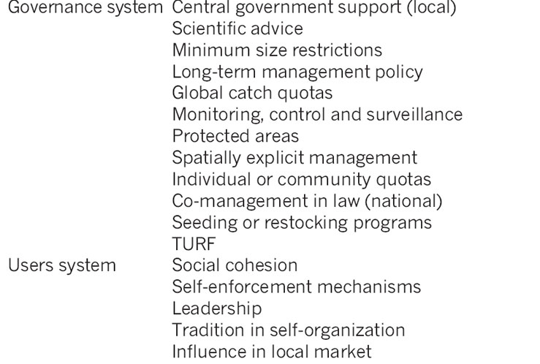
Governance attributes
Gutierrez et al. 2011

Slide 23
Co-management
In many developed fisheries, traditional approach to management is ‘top-down’.
can raise the costs of fisheries management, particularly monitoring and enforcement costs,
fails to fully draw upon the skills and expertise of fishers.
Co-management arose from realization that fishers can make important and critical, input into ensuring desirable management outcomes.
Suggests ‘bottom-up’ models of fisheries governance may deliver better results, and at possibly lower public costs.
Grafton (2005) Ocean & Coastal Mgmt

Slide 24
Governance & Management Institutions: EBFM
Conundrum with respect to EBFM and institutions:
work within existing structures or develop new ones?
Most countries are trying to proceed with EBFM within existing structures, as an evolving process.
The countries that have new management structures for EBFM also have new enabling legislation.

Slide 25
Benchmarking factors for governance with EBFM
Accountability, authority, and responsibility
Transparency
Incentives
Risk assessment & management
Adaptability
Grafton, RQ et al. (2007), Benchmarking for fisheries governance. Marine Policy 31: 470-479.

Slide 26
The role of “The Plan”
Fishery Management Plans
Now, Fishery Ecosystem Plans
Plans stipulate the mechanisms for implementing the policies.

Slide 27
Fishery Management Plans
New England Fishery Management Council proposes rules for fishermen operating in federal waters in the Northeast.
Nine separate fishery management plans (FMPs) in effect that apply to 28 marine and one anadromous species.

Slide 28
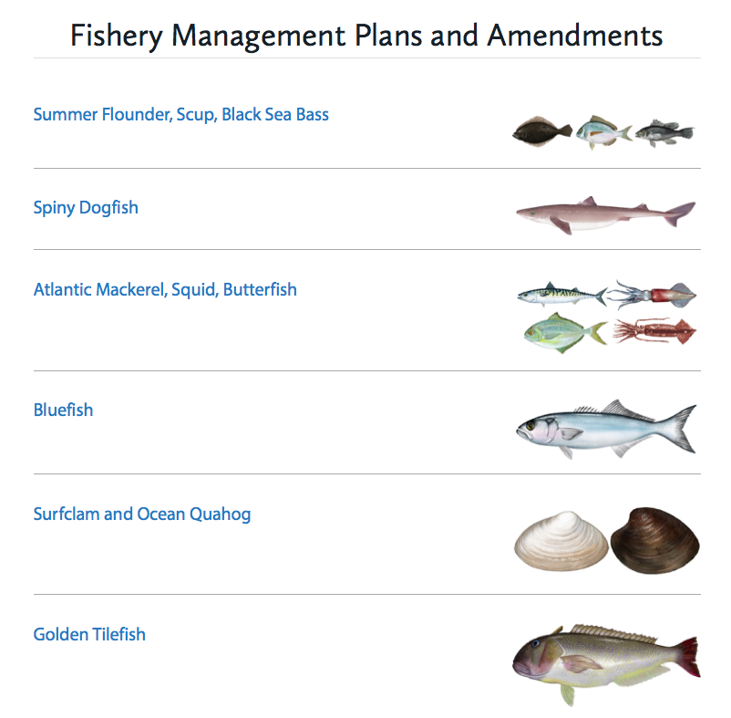
Fishery Management Plans
Mid-Atlantic Fishery Management Council

Slide 29
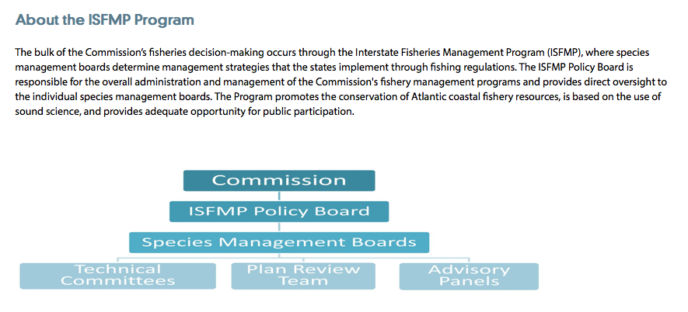
Fishery Management Plans
Atlantic States Marine Fisheries Commission
Management plans for 24 species or species groups

Slide 30
Fishery Management Plans
Management plans may cover a group of species but typically consider stocks individually.
Plans may be across jurisdictions (e.g. state and federal)
Often significant institutional administrative structure associated with each plan.
Separate management plans exist for species that interact and respond to similar drivers and pressures.

Slide 31
Fishery Ecosystem Plans (FEPs)
Most US regional fishery management councils have in place or are developing a fishery ecosystem plan.
“Fishery managers can use fishery ecosystem plans as a metric against which all fishery-specific fishery management plans are measured. This metric can help determine whether management effectively incorporates the ecosystem principles, goals, and policies of the council or NOAA Fisheries.” (NOAA Fisheries)
Current moves largely provide this as a framework for considering ecosystem information in current management and governance structures.

Slide 32
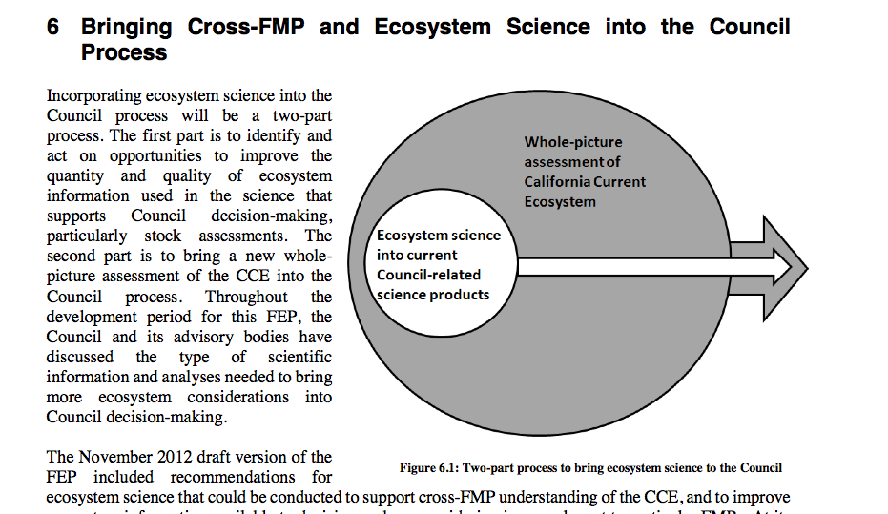
Pacific coast Fishery Ecosystem Plan (PFMC)
fwe

Slide 33
Combating Complexilliness
Current management structure is very complicated and inconsistent.
An ecosystem approach actually has a chance to make management institutions simpler.
The ecosystem and what we consider might be more complex and less certain, but under an EBFM approach we are considering a broad range of factors simultaneously.
Recall the quota ceiling approach for North Pacific
What if we tracked single-species to ensure few were overfished, but managed at an aggregate biomass level? More integrative.

Slide 34
Combating Complexilliness
Many places are now moving towards an MSE (management strategy evaluation) process as part of the institutions that interface between the ecosystem/biota and socio-economic considerations.
That process (described more next week) has embedded within it an “operating” model that could be one of any of the models we have discussed.
The actual process is much simpler than piece-mealing everything together.

Slide 35
What do we need?
INFORMATION:
Further descriptions of the complexity of fisheries institution/management considerations
RESEARCH:
Case studies and “autopsies” of what worked, what didn’t globally with respect to management/governance institutions.
Development (and application) of best practices
PROCESS:
Working within existing legislation and structure
Developing novel legislation and structures if management institutions need updating/alterations with respect to ecosystem considerations.
Keep it simple.

Slide 36
Doing EBFM
Questions?

Slide 37
What’s Next?
Evaluating Tradeoffs
Discussion on:
Sainsbury & Sumaila 2003
de la Mare 2005
Worm et al. 2009
Fulton et al. 2014

Slide 38
Mechanisms for Involving Stakeholders
When and where:
In US, certainly there is now representation at the Council/Commission level, and some of its subcmtes
Lots of local “special interest” groups and organizations
Could there be more?

Slide 39
Mechanisms for Involving Stakeholders
More options for involving stakeholders:
Workshops, both training and interactive (e.g. MREP)
Cooperative Research
(More) Involvement in SARC technical cmtes, PDTs, etc.
Maybe the need to remove complexity and frustration of the process…

